Slide 1

IOT HOME AUTOMATION USING THREE TIER SERVER ARCHITECTURE
Submitted in partial fulfilment for the award of the degree of
Bachelor of Technology
in
ELECTRONICS AND COMMUNICATION ENGINEERING
Submitted by:
19BTREC054 | G.VAISHNAVI
19BTREC004 | A.NAGA SREE REDDY
19BTREC028 | P.MANI VARDHAN
19BTREC025 | P.GIRIDHAR REDDY
Batch No. Batch 2019-23/AY 2021-22/B7
Date of Presentation:
DR.CHALUVARAJA SIR
Professor
Department of Electronics and Communication Engineering
Faculty of Engineering and Technology
JAIN DEEMED-TO-BE UNIVERSITY

Slide 2

ABSTRACT :
In this project we are implementing IOT home automation using a three tier server architecture. The IOT server is connected to the DNS server from a UDP source. The home automation is constructed using 3 servers accordingly for different home appliances and then the architecture is built.

Slide 3
OBJECTIVE :
The primary goal of this study is to create and construct an IoT-based home automation system capable of managing and automating most household appliances via a user-friendly web interface.
Because the suggested system uses Wi-Fi technology to connect its scattered sensors to a home automation server, it provides a lot of versatility.

Slide 4
HOME AUTOMATION :
Home automation allows you to operate your home's devices from anywhere in the globe using a mobile device.
Home automation is the integration of numerous technologies into a single system, rather than a single technology.

Slide 5
The term "home automation" refers to the automation of a home, often known as a "smart home" or "smart house." You can manage your gadgets such as lights, fans, and televisions through the IoT home automation ecosystem.
Wall-mounted terminals, tablet or desktop computers, a smartphone application, or an online interface that may even be accessed off-site through the Internet are all used to control the system.

Slide 6
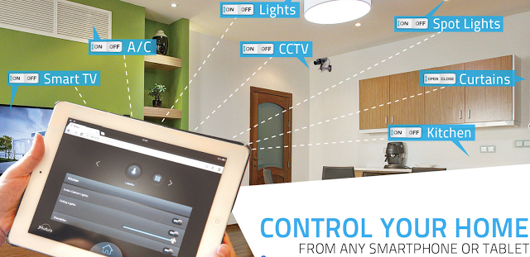

Slide 7
APPLICATIONS OF HOME AUTOMATION :
Improved home safety and security
Home air quality and water quality monitoring
Smart switches / smart locks
Smart energy meters

Slide 8
THREE TIER ARCHITECTURE :
The Three-Layer IoT Architecture is the foundation of the Internet of Things. Sensors, actuators, and other smart devices are examples of gadgets that make up a physical IoT layer. In the Internet of Things, these are referred to as "Things.“
Three Tier Architecture constist of three layer
They are:
Perception layer
Network layer
Application layer

Slide 9
PERCEPTION LAYER :
Environment-interacting sensors, actuators, and edge devices
NETWORK LAYER :
In collaboration with the application layer, discovers, connects, and translates devices over a network.
APPLLICATION LAYER:
Data processing and storage with specialized services and functionality for users

Slide 10
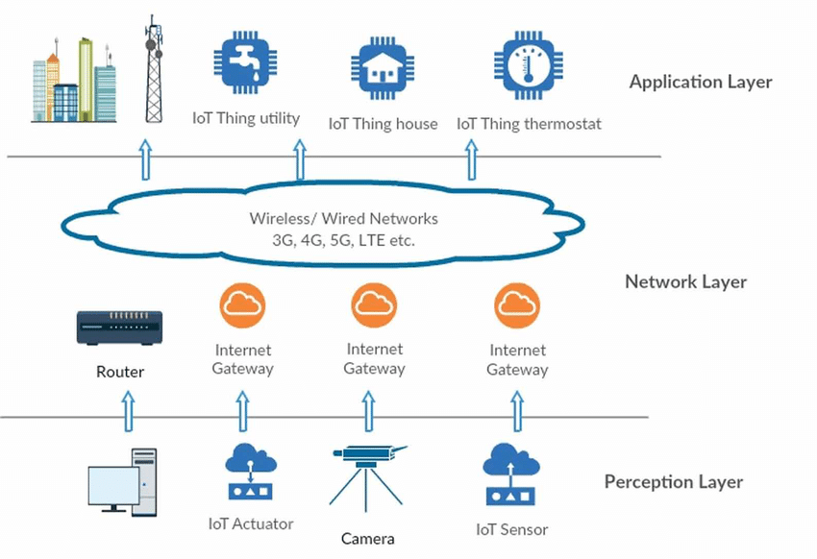

Slide 11
CISCO PACKET TRACER :
Packet Tracer is a cross-platform visual simulation tool designed by Cisco Systems that allows users to create network topologies and imitate modern computer networks.
The software allows users to simulate the configuration of Cisco routers and switches using a simulated command line interface.

Slide 12
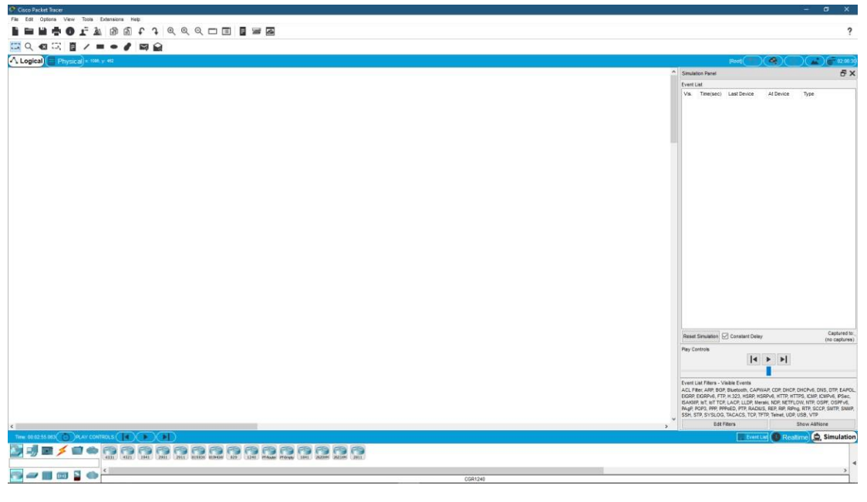
A CISCO PACKET TRACER TOOL IS USED FOR THIS PROJECT.

Slide 13
CONCLUSION :
Internet of Things (IoT) Smart Home based on the Module may be constructed with various components hardware support so that it can be assembled into a smart home system
The Internet of Things (IoT) based Module may be used to control various aspects of home electronics, such as lighting controls, fan control, temperature monitoring, early warning systems, and so on.

Slide 14
THANK YOU!!!
Any Question?

